Slide 1
Cloud-Based Light Switch
By Edgar Lopez
CSE 145

Slide 2

Light is good
Rely on it everyday
...but we abuse it

Slide 3
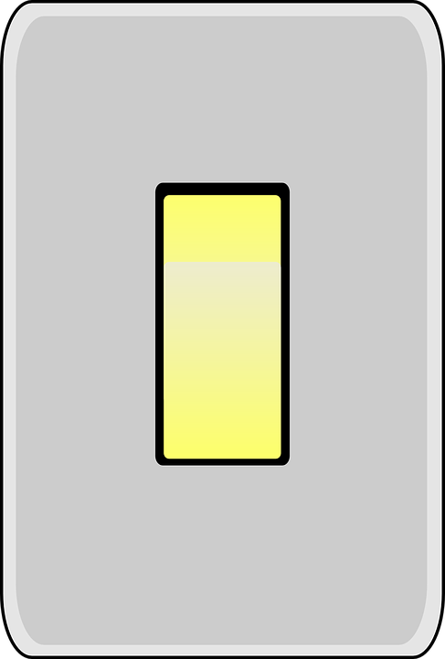
We waste light
Forget to turn it off...
when in another room
when we go off on our day

Slide 4

This costs us $$$*
Fluorescent Bulb | Incandescent Bulb
36 kWh | 176 kWh
$5.40 Annually | $26.40 Annually
* Based on kilowatt hour usage for eight hours per day.
** Based on SDG&E data & rates.

Slide 5


Consider...
Multiple lights in each household
Typical three bedroom:
12 lights
At worst: $316.80

Slide 6

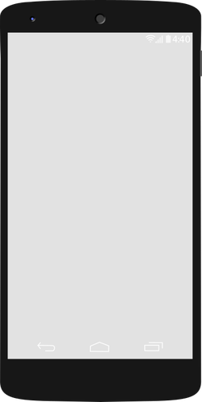
Solution
Control lightswitch with mobile phone

Slide 7
Goals
Interface microcontroller with wifi and home router (MC<------>WiFi<------>Router)
Create cloud-based mobile application to control home light (Android<----->Cloud Service)
Cloud to Wifi command parsing (Cloud Service<----->Wifi)

Slide 8
The Big Picture

Slide 9



Technologies
Arduino Pro Mini
ESP8266 WiFi chip
ThingSpeak
Android platform

Slide 10
Questions?

